Slide 1


Creating a hybrid and multi-cloud strategy using Azure API Management
Eldert Grootenboer

Slide 2



Eldert Grootenboer
@egrootenboer

Slide 3

Hybrid API Management

Slide 4

Solving our API strategy challenges
Connected experiences
Abstract
Secure and protect
Smarter services
Manage lifecycle
Monitor and measure
Discover
Get access
Try
SDKs and samples
Consume
Mediate
Publish
Developer portal
Gateway
Azure portal
APIs
App Developers
(use APIs)
API Publishers
(provide APIs)
Services and data
Notes:
Talk about the challenge, and how API Management solves each of these.

Slide 5
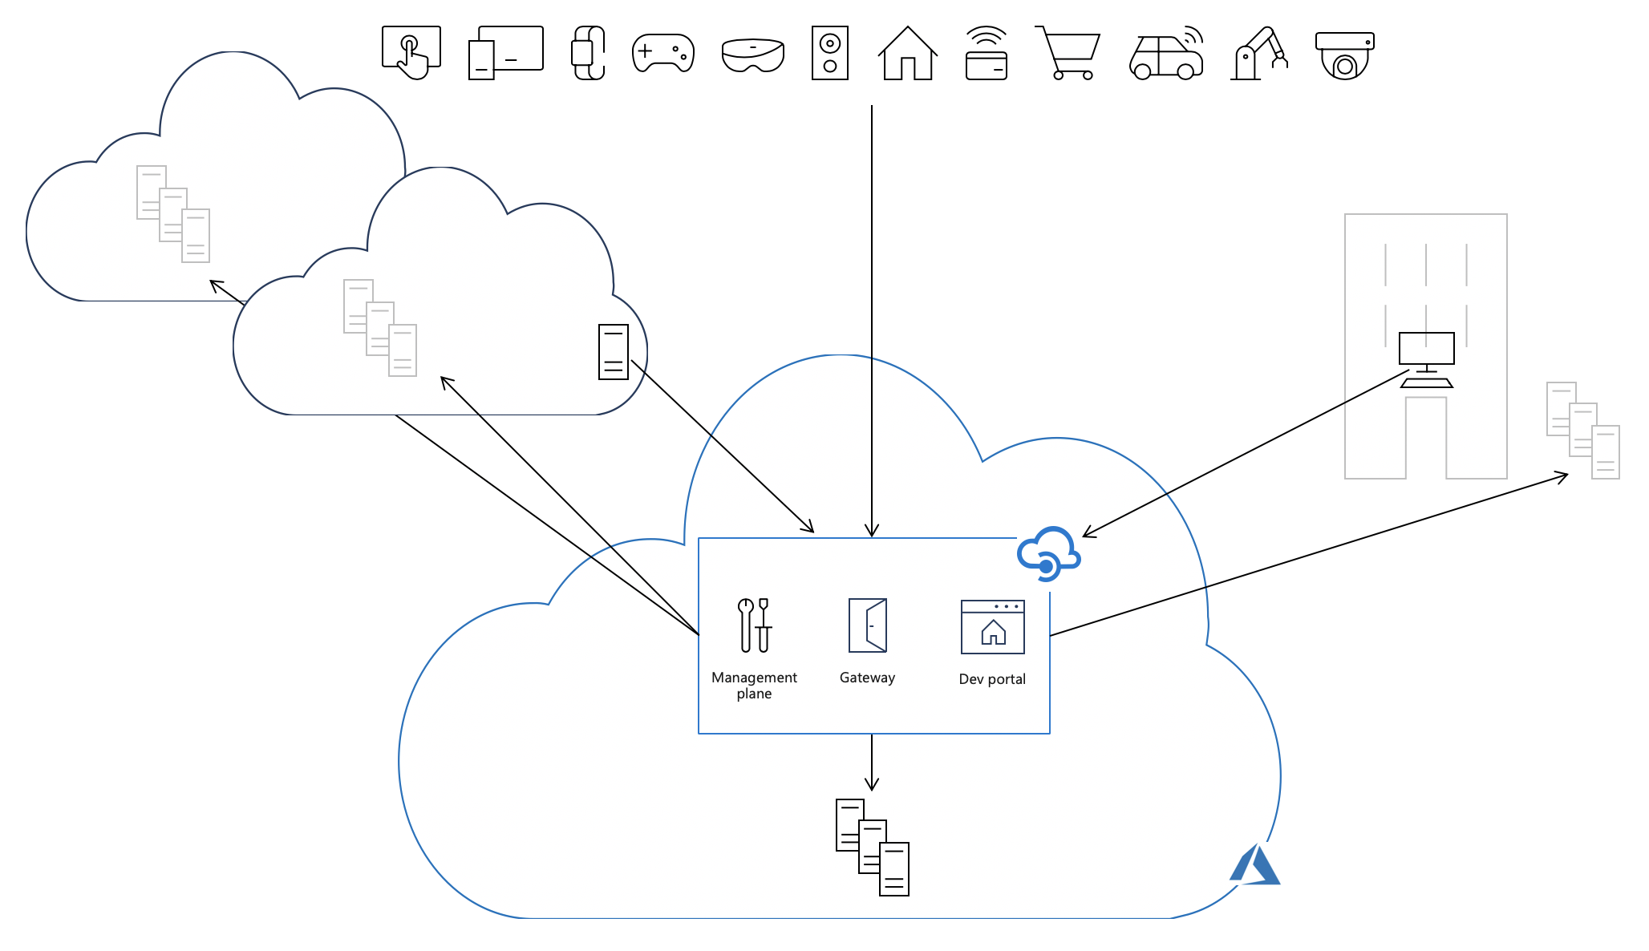
Using Azure

Slide 6









Azure Hybrid
Azure Stack
Azure IoT
Azure Arc
Integrated systems
Any edge device
Any datacenter, any cloud
Notes:
Get databases, Kubernetes clusters, and servers sprawling across on-premises, edge and multicloud environments under control by centrally organizing and governing from a single place.

Slide 7
Azure Arc
Run Azure services anywhere
Extend Azure management across your environments
Adopt cloud practices on-premises
Implement Azure security and governance anywhere

Slide 8
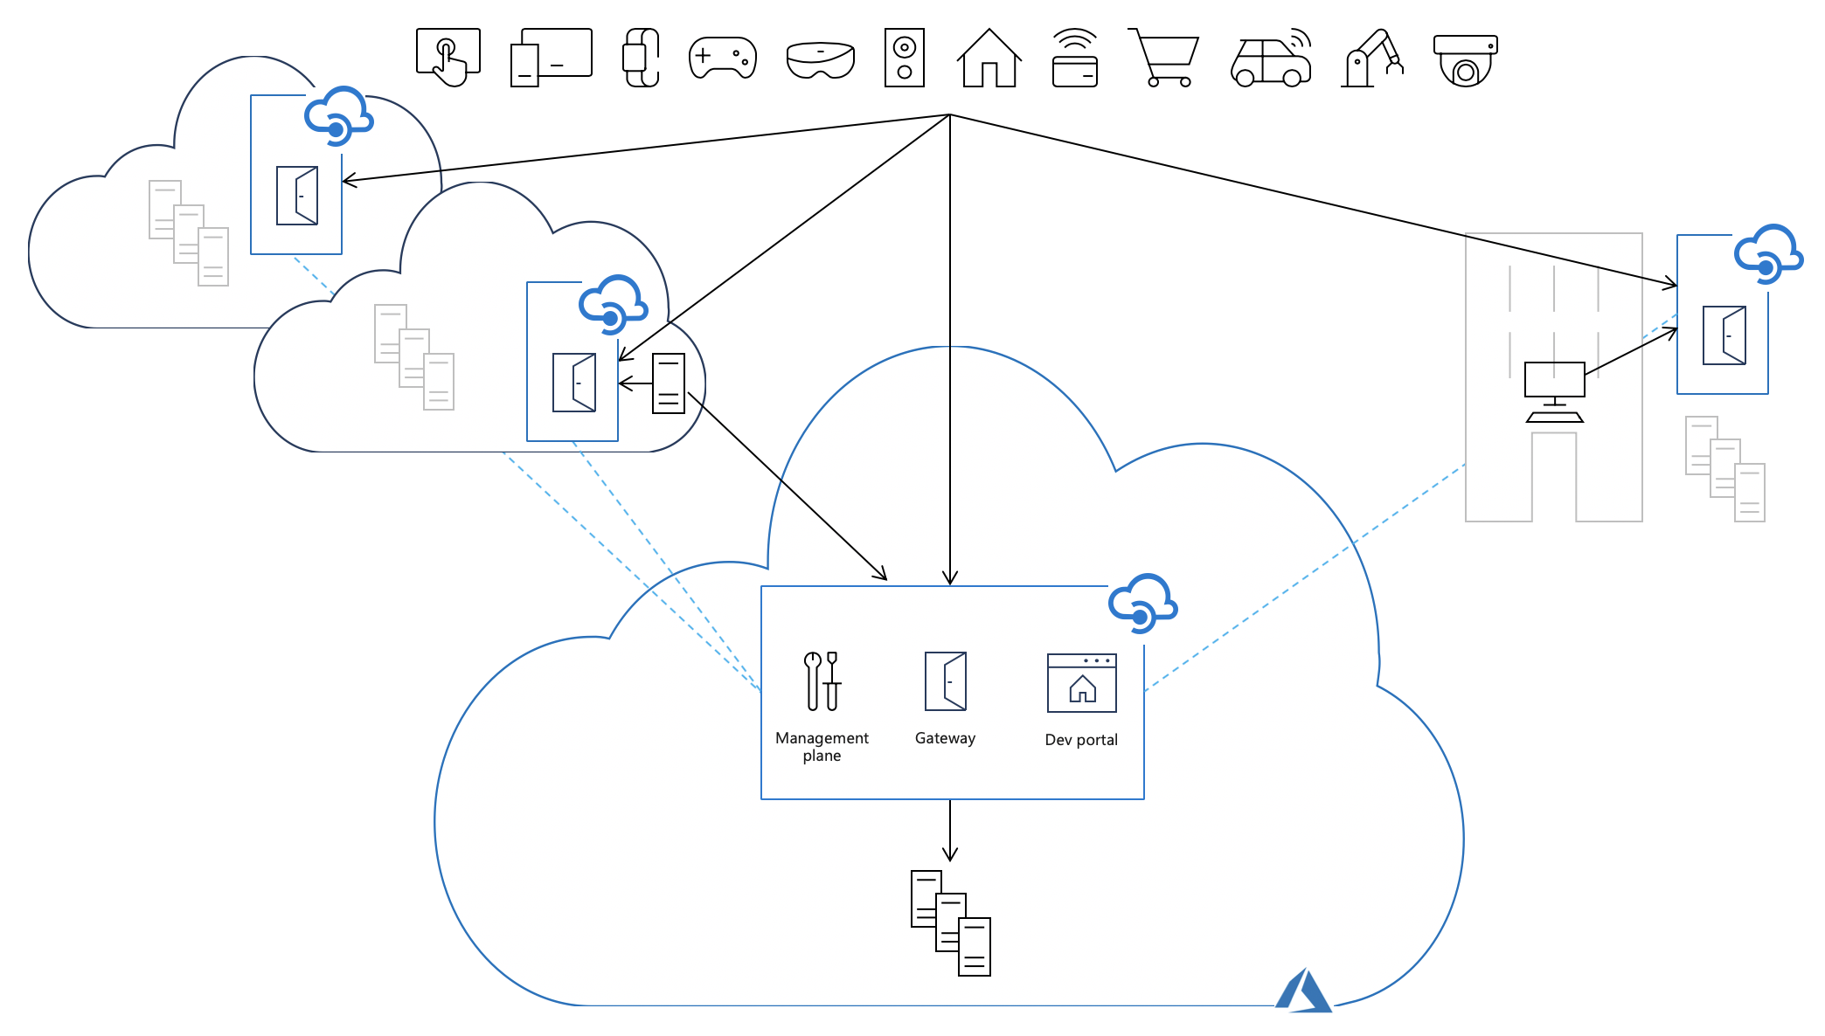
API Management self-hosted gateway

Slide 9

Features

Slide 10



Centralized management
Manage from Azure
Pushed to local instances
Overview of all instances

Slide 11
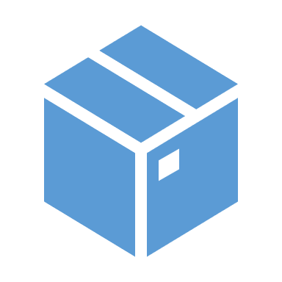


Containerized
Run on any container orchestrator
Image available from Microsoft Container Registry
Most features available

Slide 12



Work disconnected
Fail static
Use in-memory configuration copy
Optionally use local backup

Slide 13

Scenarios

Slide 14

On-premises environment
Large on-premises landscape
Systems communicating with each other
No need to go out to the internet
Notes:
Different applications that will remain on-premises, but we still want the advantages of APIM, without the need to go out to the cloud and add latency and security risks

Slide 15

Cloud Migration
From on-premises to cloud
Some active, some waiting for phase-out
Low latency between systems
Notes:
Hybride situatie tijdens cloud migratie

Slide 16

Sensitive data and services
Systems remain on-premises
Expose to outside world via APIs
Security and governance
Notes:
Some data and services are not allowed to move to the cloud, but we still want to have the same governance and security

Slide 17

Work disconnected
Intermittent connection
Small API landscape in different locations
Single point of management

Slide 18

Multi-cloud
Downtime is not allowed
Deploy to multiple clouds
Different clouds have different strengths
Notes:
Run your services in multiple clouds for safety or HA purposes, or to make use of different strengths in different clouds

Slide 19
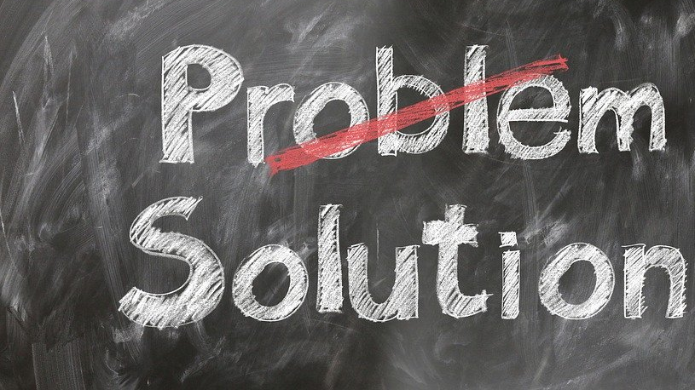
Demo time

Slide 20













Customer Scenario

Slide 21



Azure Solution
Azure Database
RetrieveRegistration
Function
Azure API Management

Slide 22

Create Local
SQL Server Database
RetrieveRegistration
Function
Self-hosted Gateway with subset of APIs
Notes:
Create gateway in portal
Add APIs to gateway
Get env.conf and update on VM
Deploy container

Slide 23


Connect
SQL Sync
CheckIn Function
Switch Over

Slide 24



Managability
Single place of configuration
Environment specific variables
Single pane of glass

Slide 25

Almost done

Slide 26


Take aways
Expose services running anywhere
Single configuration and management
Think about running disconnected

Slide 27



Thank You!
@egrootenboer
eldert@eldert.net
https://www.linkedin.com/in/eldert-grootenboer

